Slide 1
Computer Programming Adv
12
TEKNIK
Hosting
Teknik Elektro

Slide 2


init the environment
Make sure in package.json
Create a new file named Procfile

Slide 3

https://www.heroku.com/

Slide 4
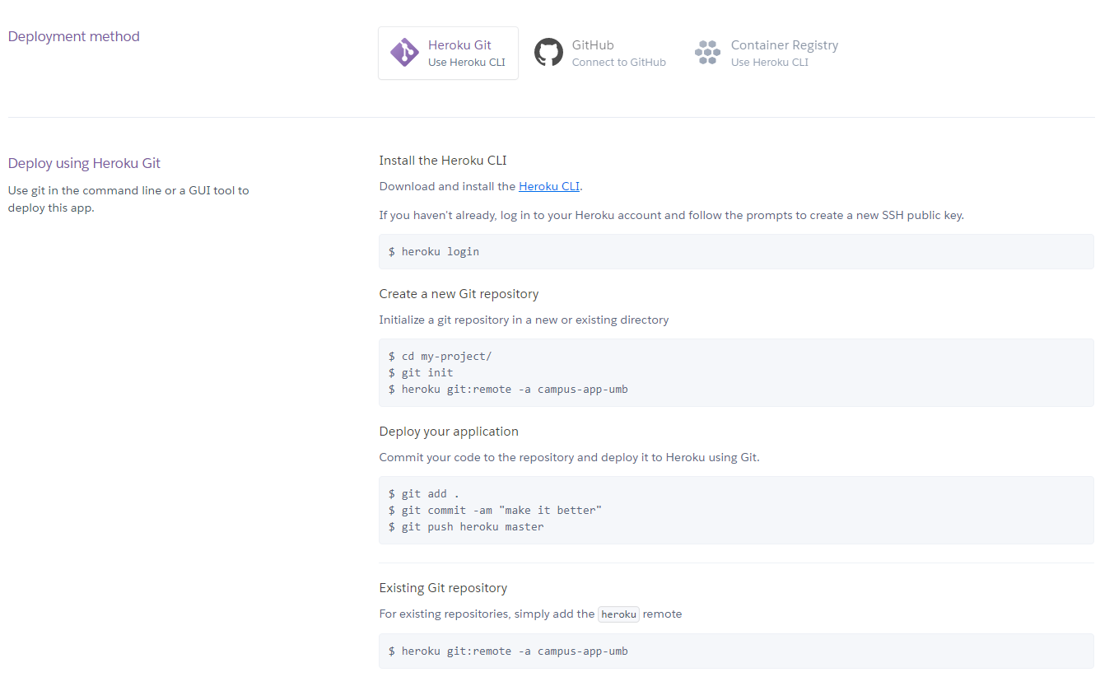
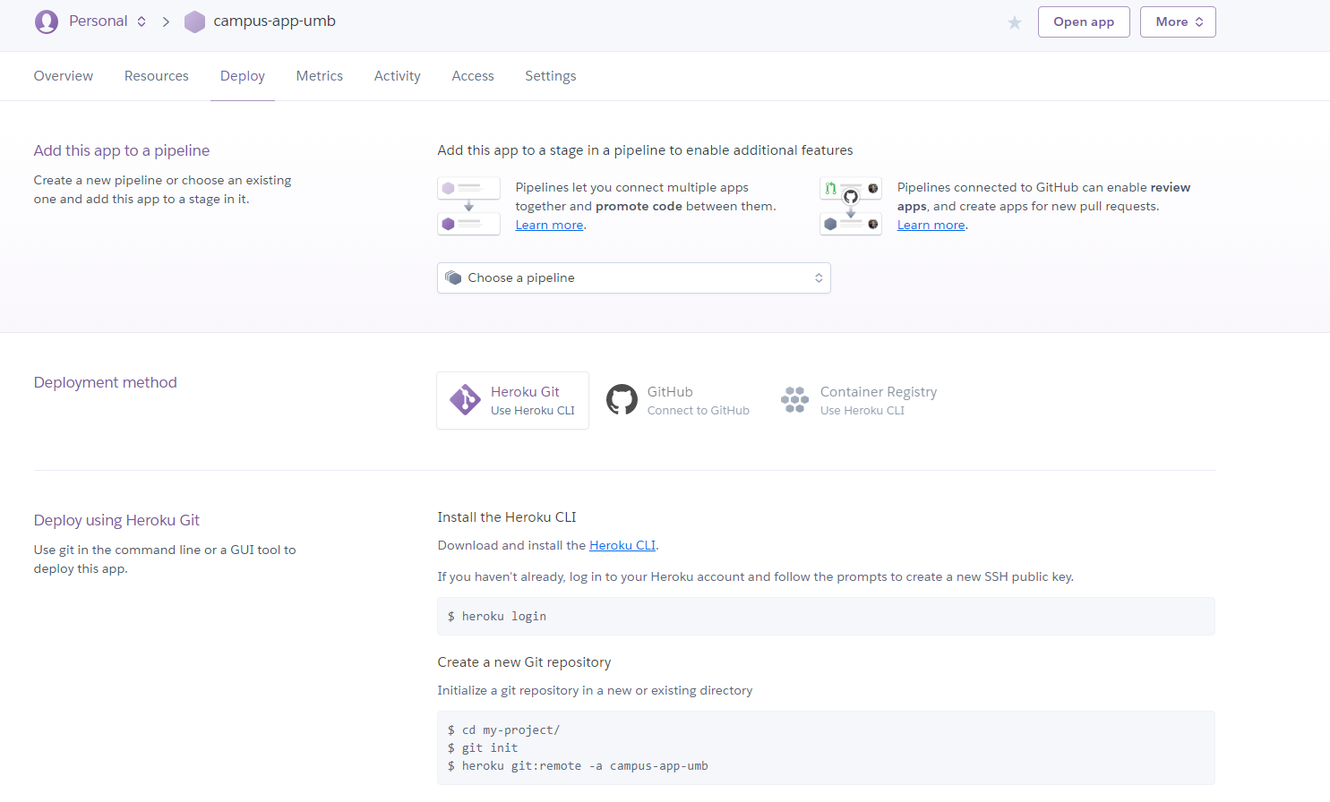
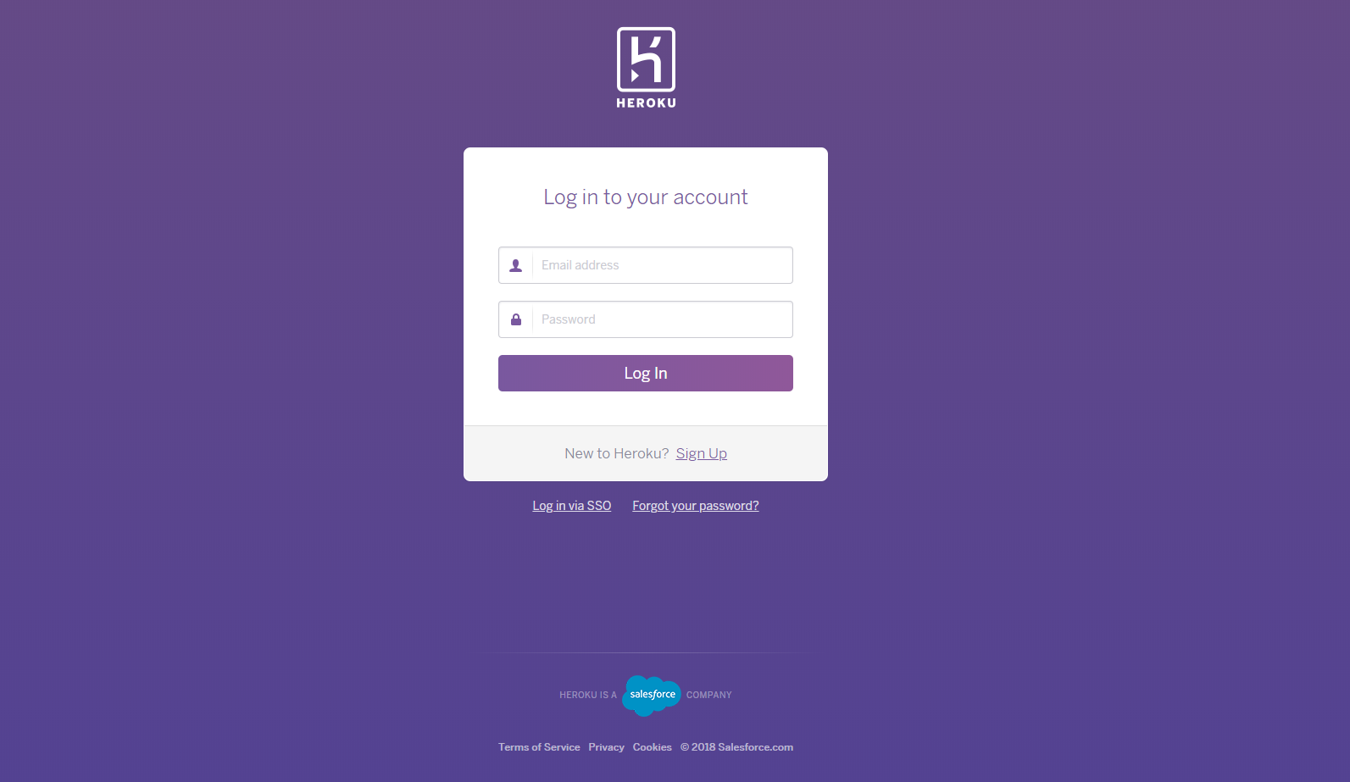
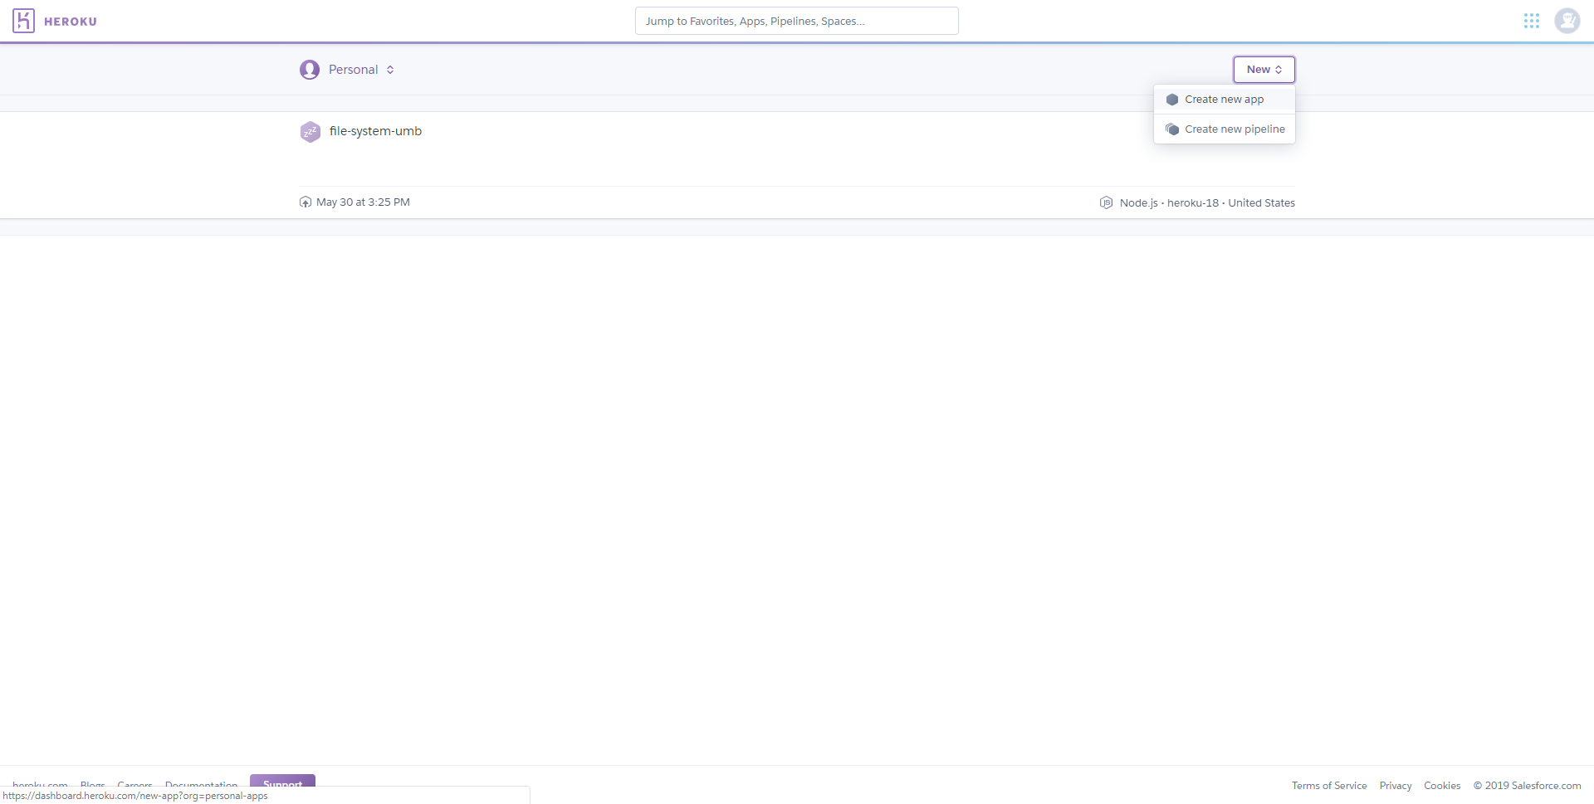
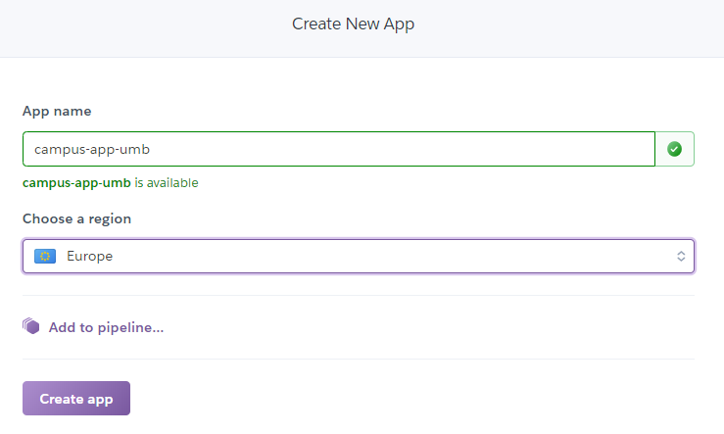
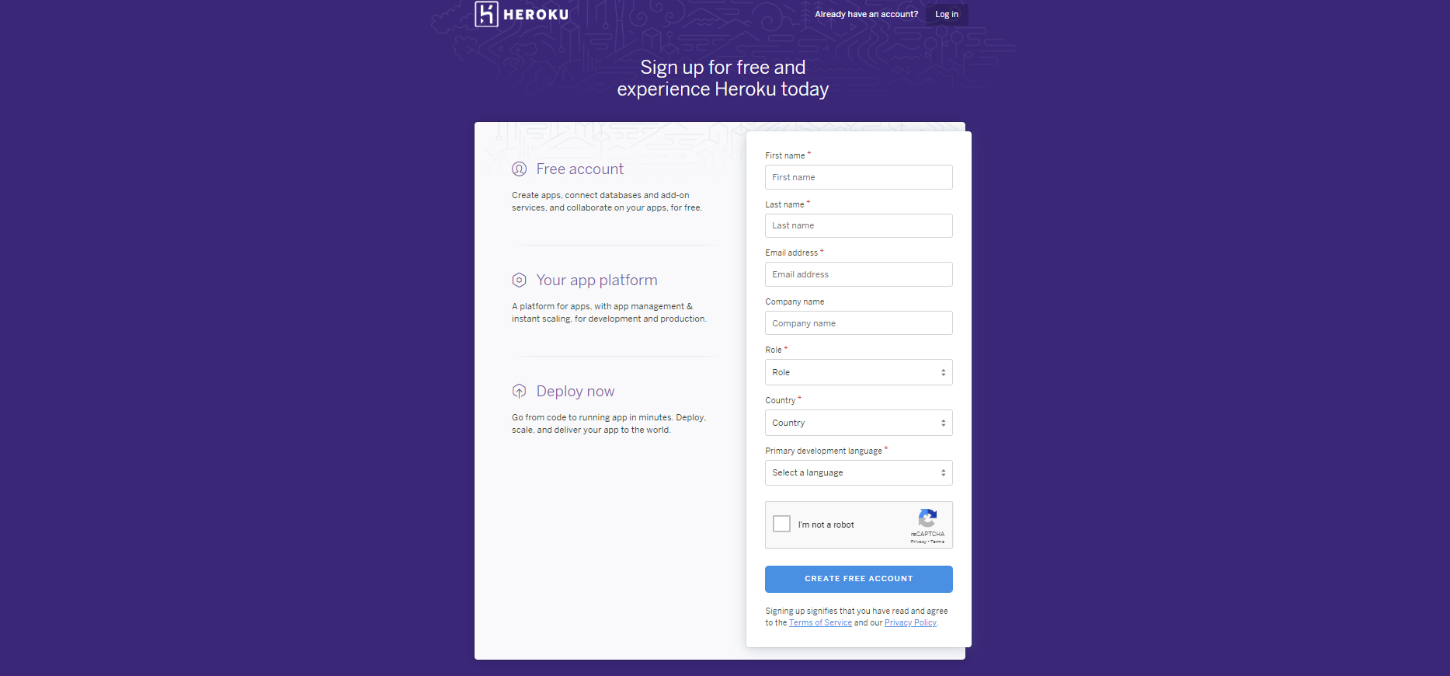


Slide 5
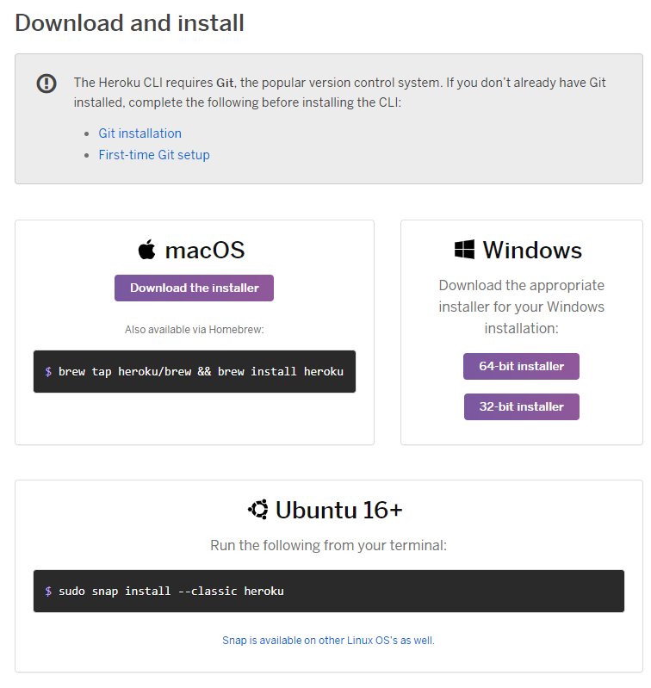
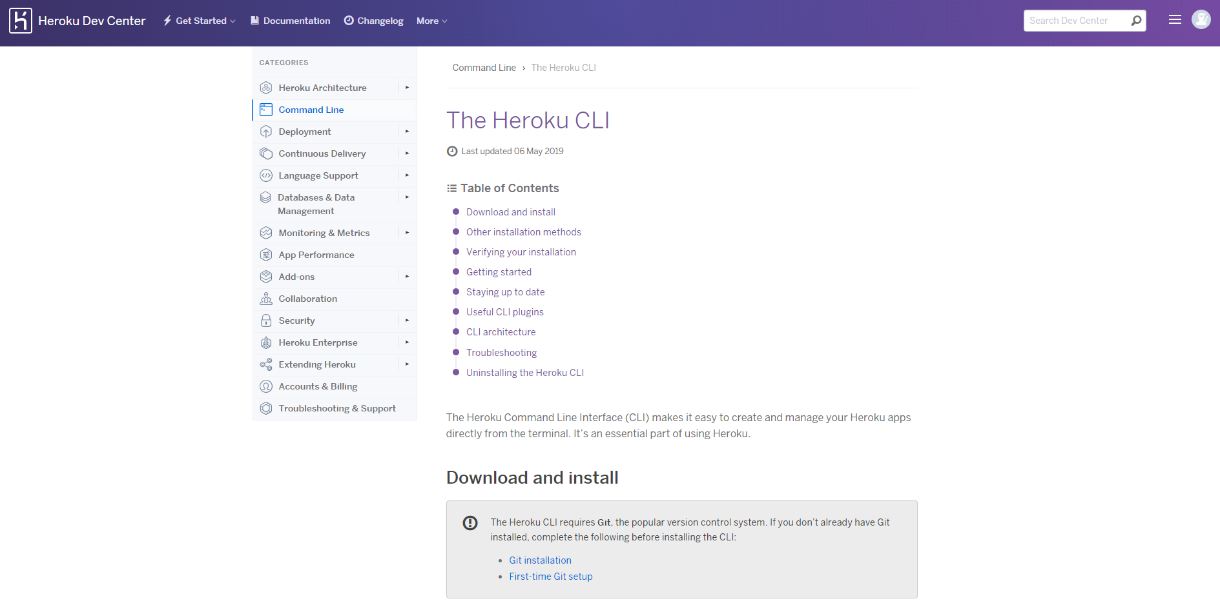
https://devcenter.heroku.com/articles/heroku-cli

Slide 6



open command prompt / terminal

Slide 7
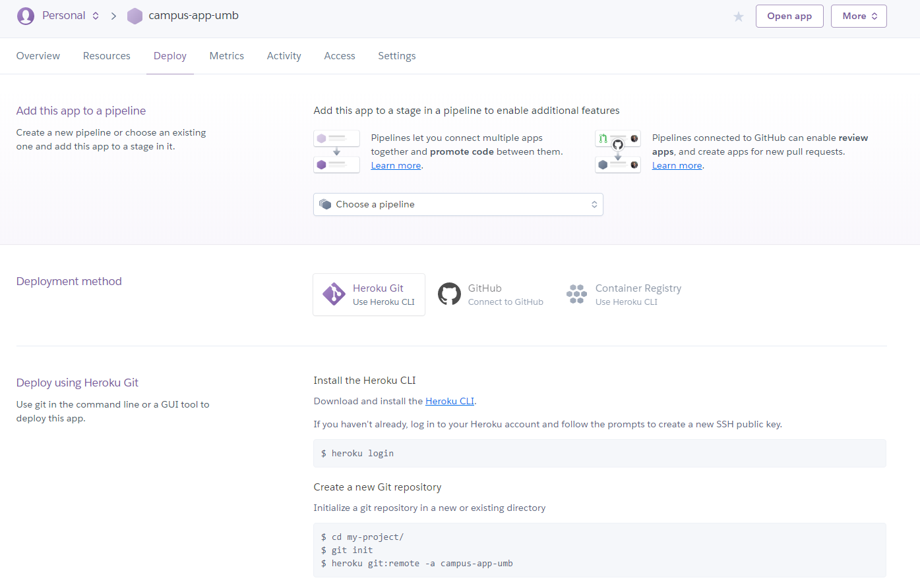

Open the app

Slide 8
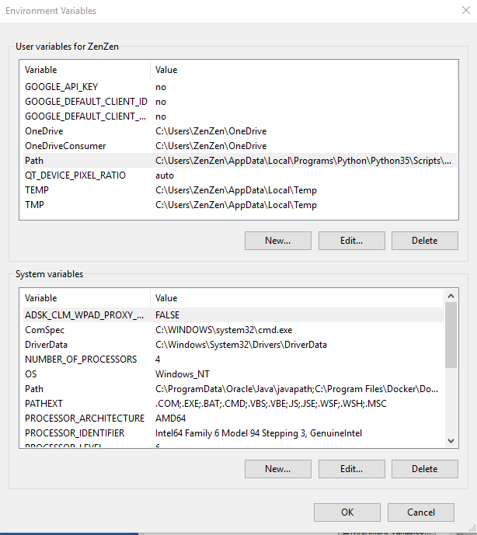
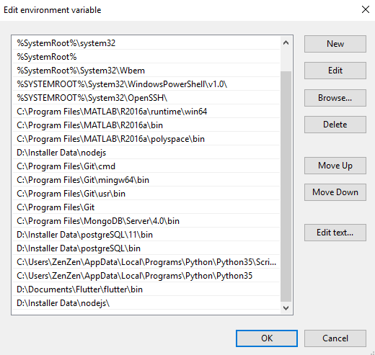
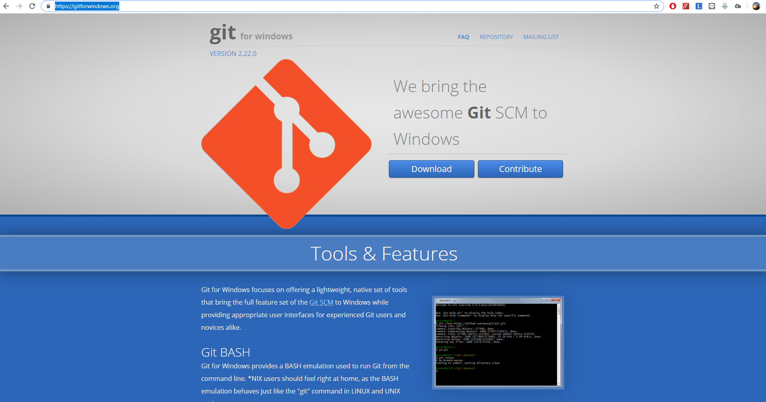
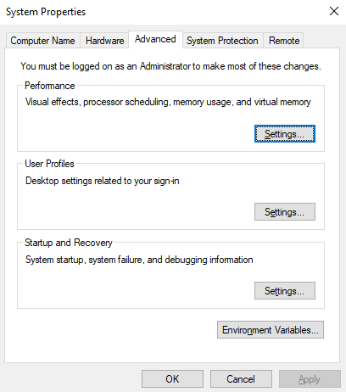
Open the app
https://gitforwindows.org/

Slide 9



Remoting & Commiting project

Slide 10
Zendi Iklima ST, SKom, MSc

